Slide 1

Experimental Design

Slide 2
Multi-Way ANOVA and Interactions
Notation
Replication
Unbalanced Data
Notes:
2

Slide 3
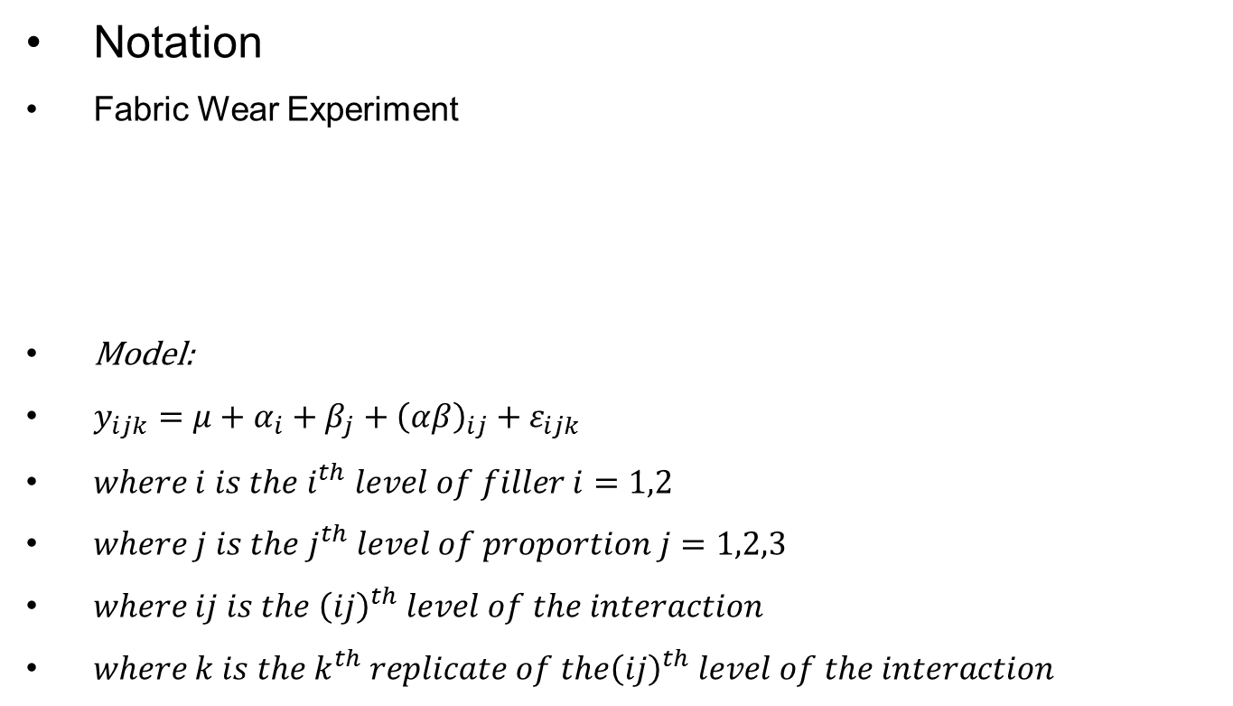
Multi-Way ANOVA and Interactions
Notation
Fabric Wear Experiment
Model:
$y_{ijk}=μ+α_{i}+β_{j}+{\left(αβ\right)}_{ij}+ε_{ijk}$
$where i is the i^{th} level of filler i=1,2$
$where j is the j^{th} level of proportion j=1,2,3$
$where ij is the {\left(ij\right)}^{th} level of the interaction$
$where k is the k^{th} replicate of the{\left(ij\right)}^{th} level of the interaction$
Proportion of filler
 | 25% (1) | 50% (2) | 75% (3)
1 | 155 173 | 198 177 | 235 229
2 | 137 160 | 129 98 | 155 132
Filler Type
Notes:
3

Slide 4
Multi-Way ANOVA and Interactions
Notation
Replication
Unbalanced Data
Notes:
4

Slide 5
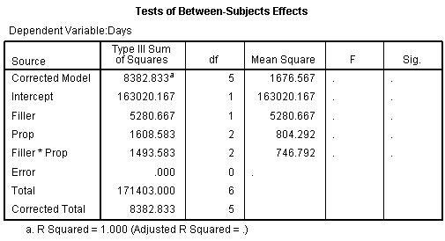
Multi-Way ANOVA and Interactions
What if the number of observations in each cell is just one?
Proportion of filler
 | 25% (1) | 50% (2) | 75% (3)
1 | 164 | 187.5 | 232
2 | 148.5 | 113.5 | 143.5
Filler Type
We don’t have information to get sums of squares and degrees of freedom for the residual error.
Notes:
5

Slide 6
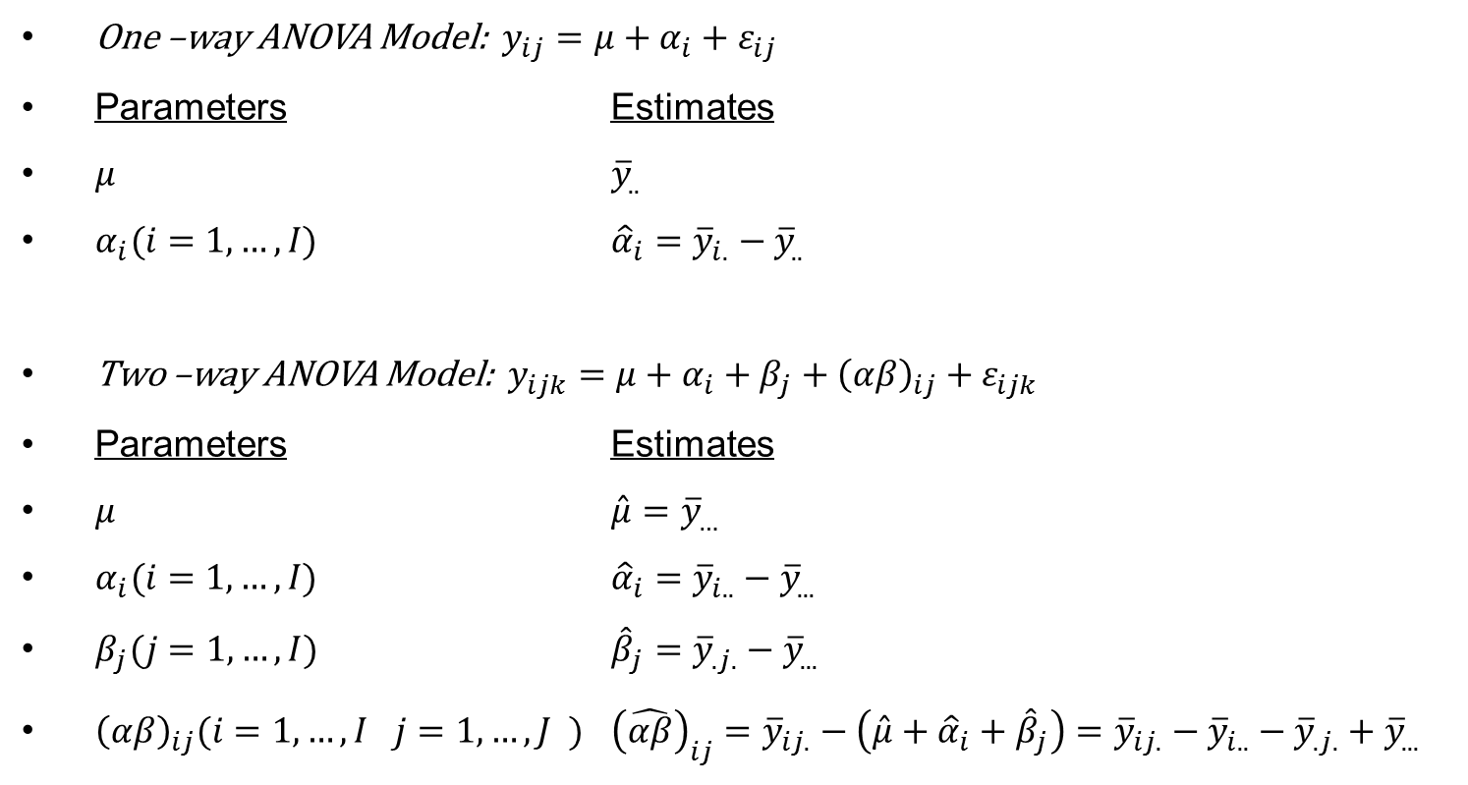
Multi-Way ANOVA and Interactions
One –way ANOVA Model: $y_{ij}=μ+α_{i}+ε_{ij}$
Parameters Estimates
$μ$ ${\overline{y}}_{..}$
$α_{i}(i=1,…,I)$ ${\hat{α}}_{i}={\overline{y}}_{i.}−{\overline{y}}_{..}$
Two –way ANOVA Model: $y_{ijk}=μ+α_{i}+β_{j}+{\left(αβ\right)}_{ij}+ε_{ijk}$
Parameters Estimates
$μ$ $\hat{μ}={\overline{y}}_{…}$
$α_{i}(i=1,…,I)$ ${\hat{α}}_{i}={\overline{y}}_{i..}−{\overline{y}}_{...}$
$β_{j}(j=1,…,I)$ ${\hat{β}}_{j}={\overline{y}}_{.j.}−{\overline{y}}_{...}$
${\left(αβ\right)}_{ij}(i=1,…,I j=1,…,J )$ ${\left(\hat{αβ}\right)}_{ij}={\overline{y}}_{ij.}−\left(\hat{μ}+{\hat{α}}_{i}+{\hat{β}}_{j}\right)={\overline{y}}_{ij.}−{\overline{y}}_{i..}−{\overline{y}}_{.j.}+{\overline{y}}_{...}$
Notes:
6

Slide 7
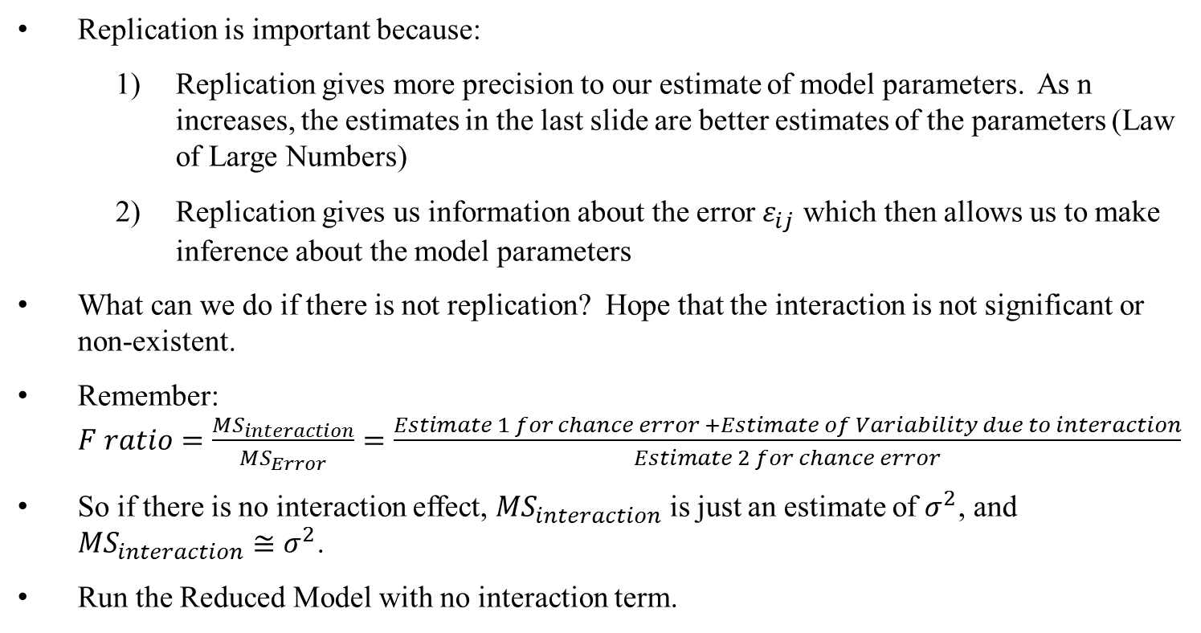
Multi-Way ANOVA and Interactions
Replication is important because:
Replication gives more precision to our estimate of model parameters. As n increases, the estimates in the last slide are better estimates of the parameters (Law of Large Numbers)
Replication gives us information about the error $ε_{ij}$ which then allows us to make inference about the model parameters
What can we do if there is not replication? Hope that the interaction is not significant or non-existent.
Remember: $F ratio=\frac{{MS}_{interaction}}{{MS}_{Error}}=\frac{Estimate 1 for chance error +Estimate of Variability due to interaction}{Estimate 2 for chance error}$
So if there is no interaction effect, ${MS}_{interaction}$ is just an estimate of $σ^{2}$, and ${MS}_{interaction}≅σ^{2}$.
Run the Reduced Model with no interaction term.
Notes:
7

Slide 8

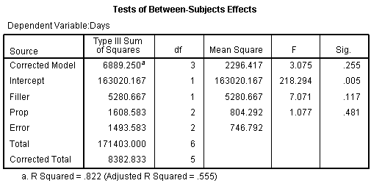
Multi-Way ANOVA and Interactions
Model with interaction:
Model without interaction:
But how do we know if it is safe to drop the interaction from the model???
Notes:
8

Slide 9
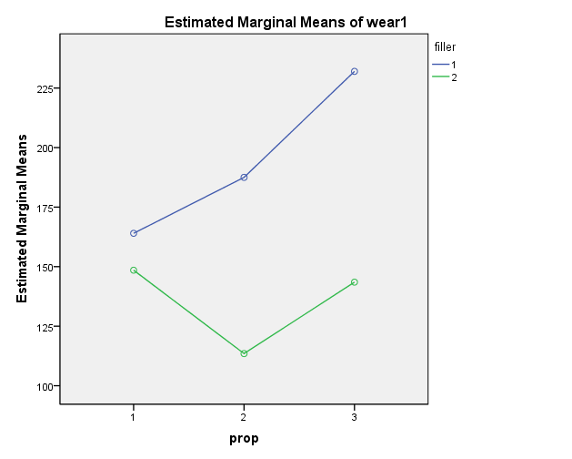
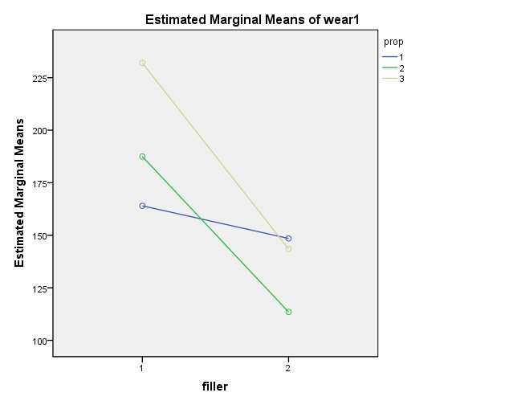
Multi-Way ANOVA and Interactions
Should we be dropping the interaction term???
Notes:
9

Slide 10
Multi-Way ANOVA and Interactions
Notation
Replication
Unbalanced Data
Notes:
10

Slide 11
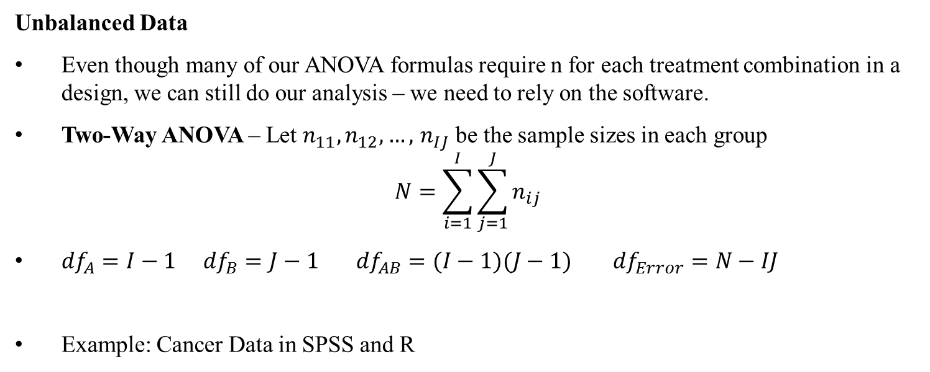
Multi-Way ANOVA and Interactions
Unbalanced Data
Even though many of our ANOVA formulas require n for each treatment combination in a design, we can still do our analysis – we need to rely on the software.
Two-Way ANOVA – Let $n_{11}, n_{12}, …,$ $n_{IJ}$ be the sample sizes in each group
$$N=\sum_{i=1}^{I}{\sum_{j=1}^{J}{n_{ij}}}$$
${df}_{A}=I−1$ ${df}_{B}=J−1$ ${df}_{AB}=(I−1)(J−1)$ ${df}_{Error}=N−IJ$
Example: Cancer Data in SPSS and R
Notes:
11

Slide 12
Multi-Way ANOVA and Interactions
Things to Remember with Unbalanced Data
Standard Formulas for estimating model parameters are often invalid
Order of the factors in the model affects SS, MS, and F-tests
Example: Cancer Data in SPSS and R
Should it matter if we put Gender or Cancer Type first in the model?
Cancer Type
 | Bladder | Bronchus | Colon | Rectum | Kidney | Stomach
Female
Male
Gender
Notes:
12

Slide 13
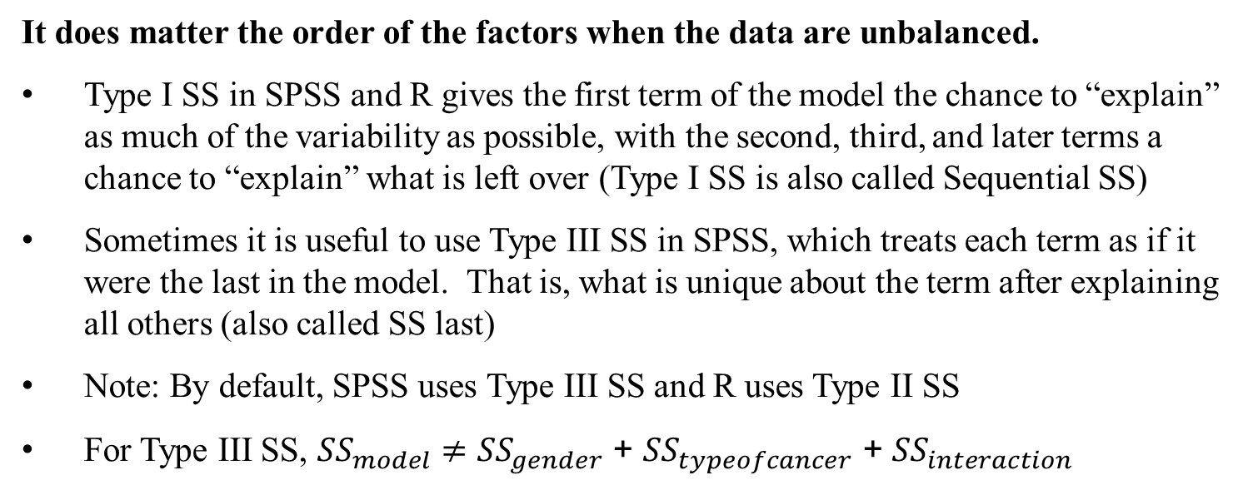
Multi-Way ANOVA and Interactions
It does matter the order of the factors when the data are unbalanced.
Type I SS in SPSS and R gives the first term of the model the chance to “explain” as much of the variability as possible, with the second, third, and later terms a chance to “explain” what is left over (Type I SS is also called Sequential SS)
Sometimes it is useful to use Type III SS in SPSS, which treats each term as if it were the last in the model. That is, what is unique about the term after explaining all others (also called SS last)
Note: By default, SPSS uses Type III SS and R uses Type II SS
For Type III SS, ${SS}_{model}≠{SS}_{gender}$ + ${SS}_{typeofcancer}$ + ${SS}_{interaction}$
Notes:
13

